Slide 1

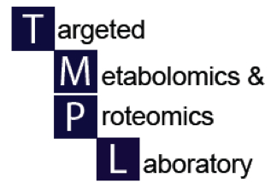

Uploading LC-MS data to XCMS online
UAB Metabolomics Workshop
December 2, 2015
Landon S. Wilson
Research Associate, TMPL

Slide 2
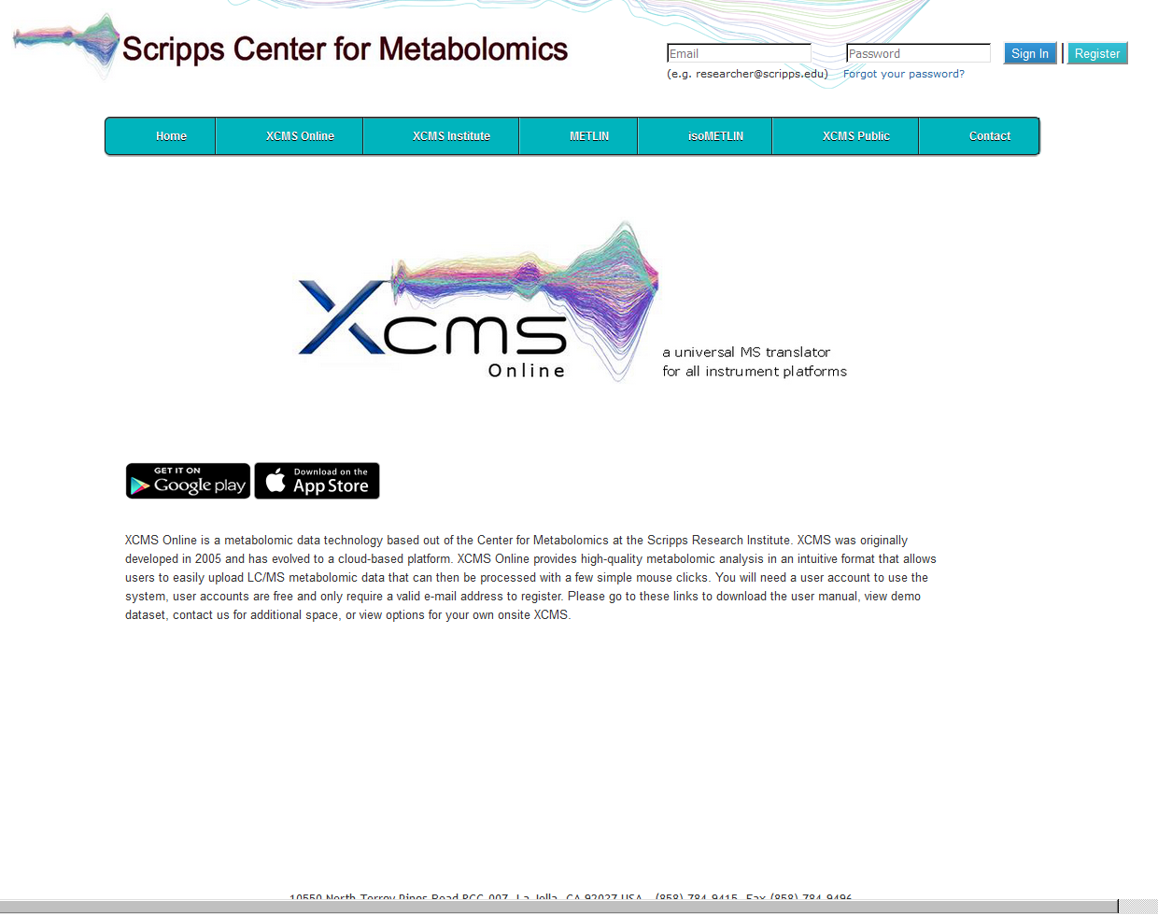
Uploading Experiments for Metabolomics Analyses using XCMS Online Applications
https://xcmsonline.scripps.edu/index.php

Slide 3
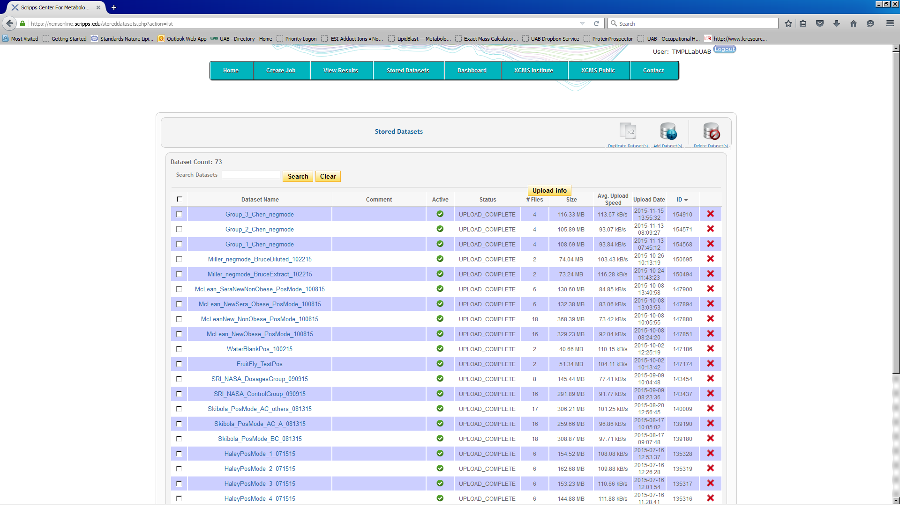
Uploading Experiments for Metabolomics Analyses using XCMS Online Applications continued…
Once you have completed your LC-MS/MS analyses of samples in your particular experiment,
files can be uploaded directly for most instrumentation types.
Select the option “Stored Datasets,” on the XCMS toolbar to access datasets already
stored, or to upload new datasets for future analyses.

Slide 4
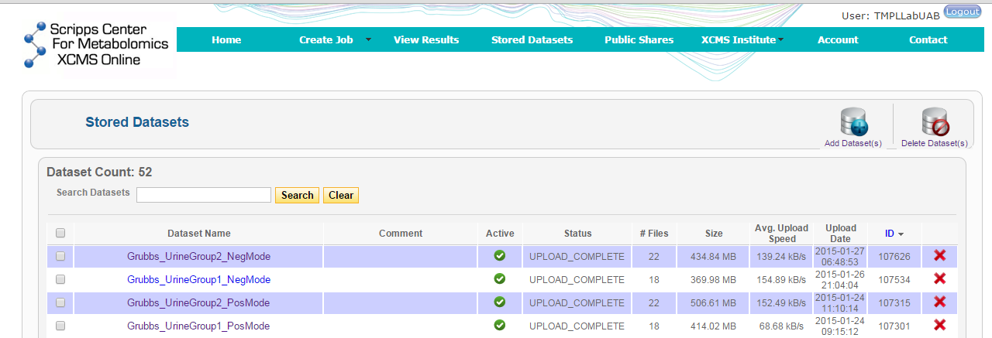
Uploading Experiments for Metabolomics Analyses using XCMS Online Applications continued…
Select the option “Add Dataset(s),” on the XCMS toolbar to open the Java directed upload
panel. Certain instruments can directly upload raw data while other must be transformed to
a universal language such as mzXML.

Slide 5
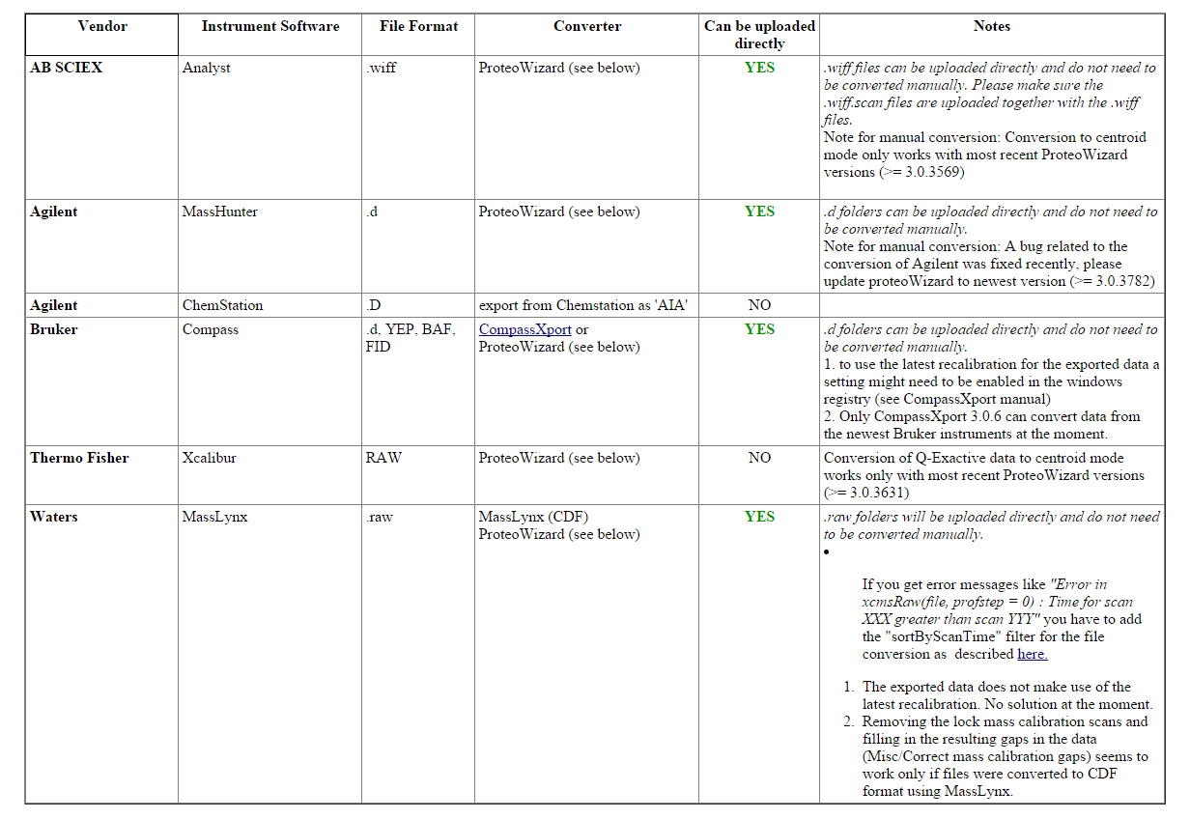
RAW data file parameters per major manufacturer

Slide 6
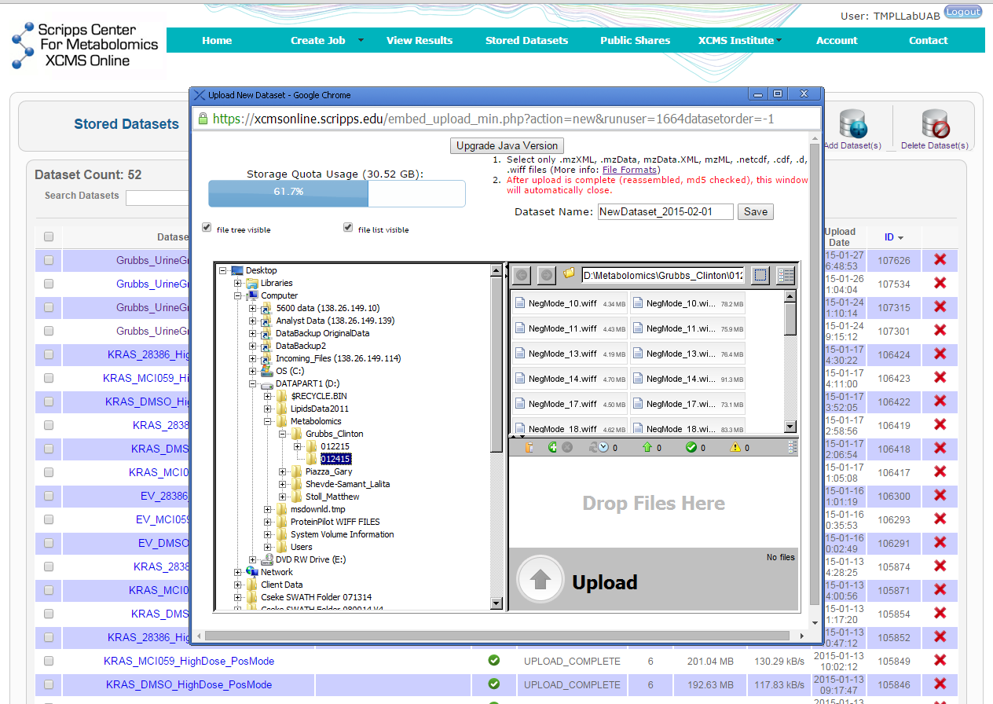
Uploading Experiments for Metabolomics Analyses using XCMS Online Applications continued…
Once the Java pop-up window opens, a standard file architecture for selecting data files is accessible. Select the files you want to add in a particular group from the top right box (1), and drag them to the “Drop Files Here” box (2) below.
(1)
(2)
(3)
Wait for the “Upload” (3) button to turn green to begin the uploading process to the XCMS
server. This might take a few minutes as the server determines if the files are in the correct format.

Slide 7
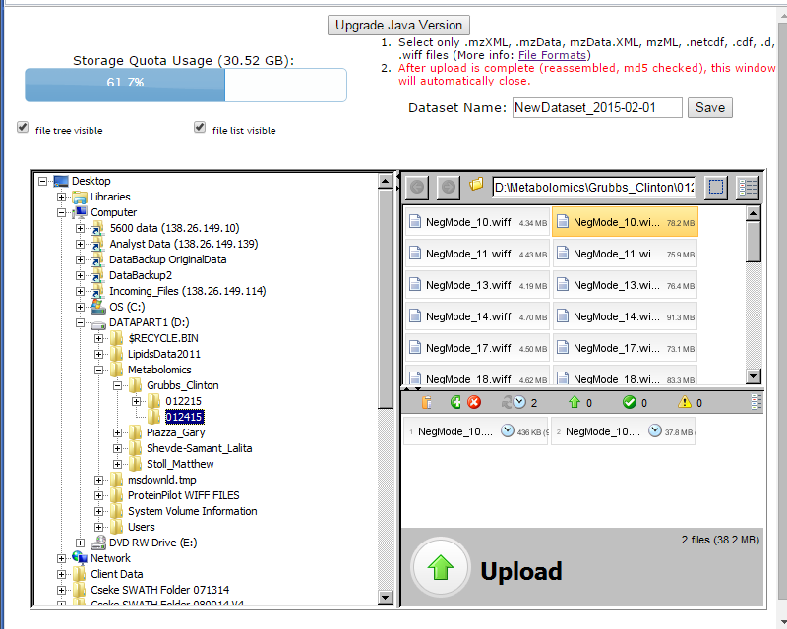
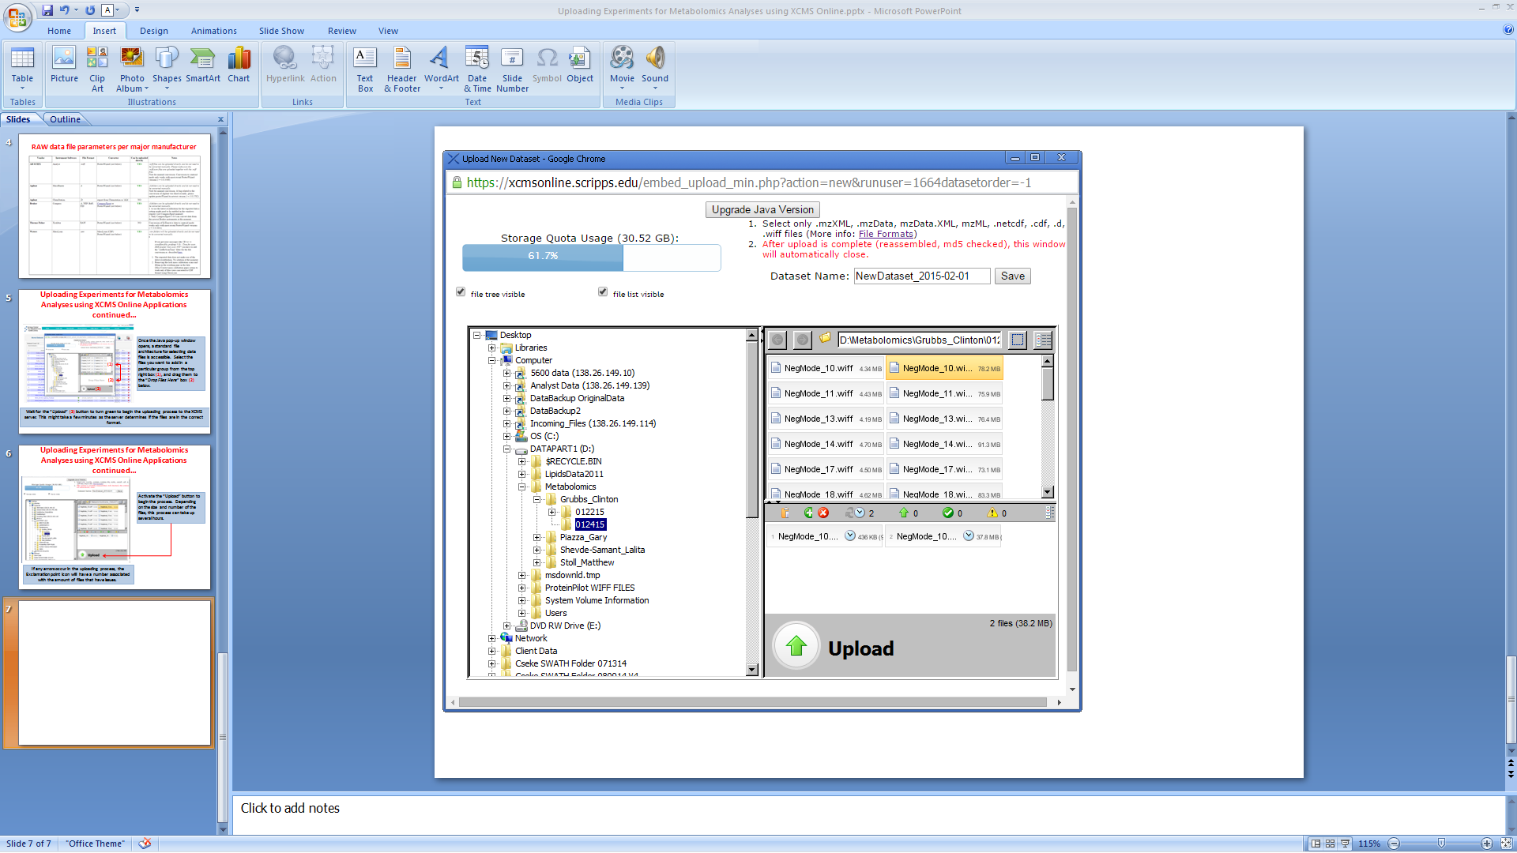
Uploading Experiments for Metabolomics Analyses using XCMS Online Applications continued…
Activate the “Upload” button to begin the process. Depending on the size and number of the files, this process can take up several hours.
If any errors occur in the uploading process, the Exclamation point icon will have a number associated with the amount of files that have issues.

Slide 8
Uploading Experiments for Metabolomics Analyses using XCMS Online Applications continued…
After the upload is complete, give a descriptive name to your data set by typing in the “DataSet Name” box and clicking Save.
Since you will be comparing a minimum of two data sets, you will repeat the process again with the additional group (s) you wish to evaluate.

Slide 9
Tips for naming files for upload to XCMS Online
Before uploading, it is a good idea to create separate file folders on your hard drive
to better organize your data into the groups you want to examine.
Add enough description to discriminate between different samples and sample set
names.
Adding the ionization mode in the name is preferable, i.e. PosMode or NegMode.
Eliminate open spaces in the data file name by using “_” (underscore) notation.
Open spaces can cause upload errors in XCMS Online.
Example of DataSet Name: Grubbs_UrineGroup2_NegMode

Slide 10
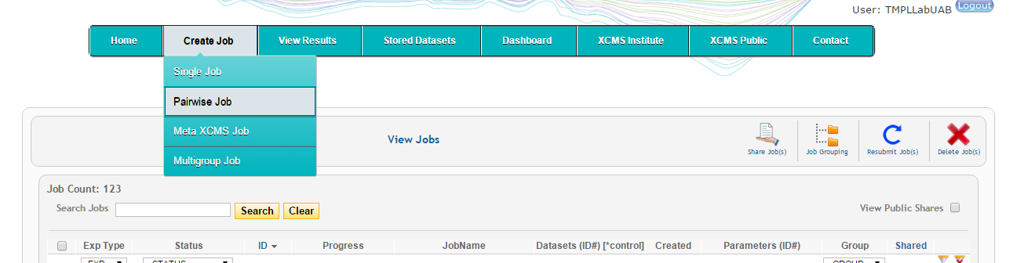
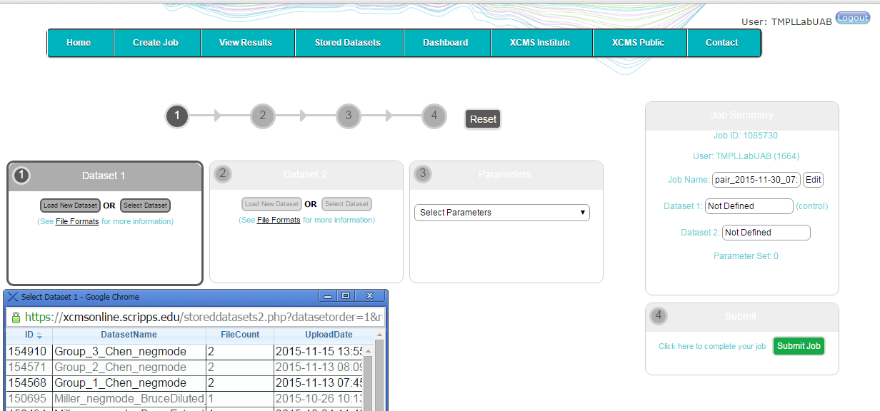
Starting a new XCMS database search…
Select the type of “Job” or test for your newly uploaded data sets.
From here, you can select the files you wish to evaluate.

Slide 11
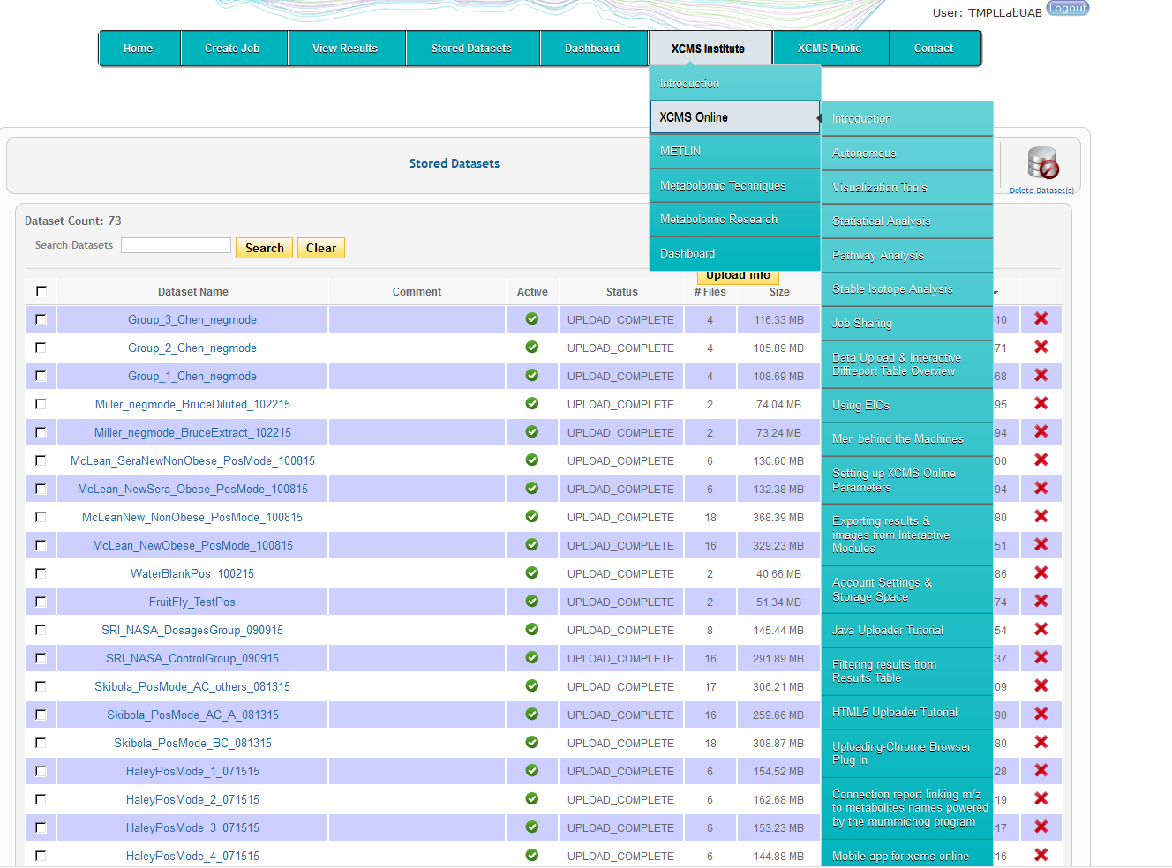
XCMS Online Tutorial Videos

Slide 12

An XCMS server
An onsite server containing the full suite of XCMS and METLIN programs and databases
Advantages – no delays in upload and processing data

